Slide 1
ISO 20022
API Resource Registration Process
Flow charts

Slide 2
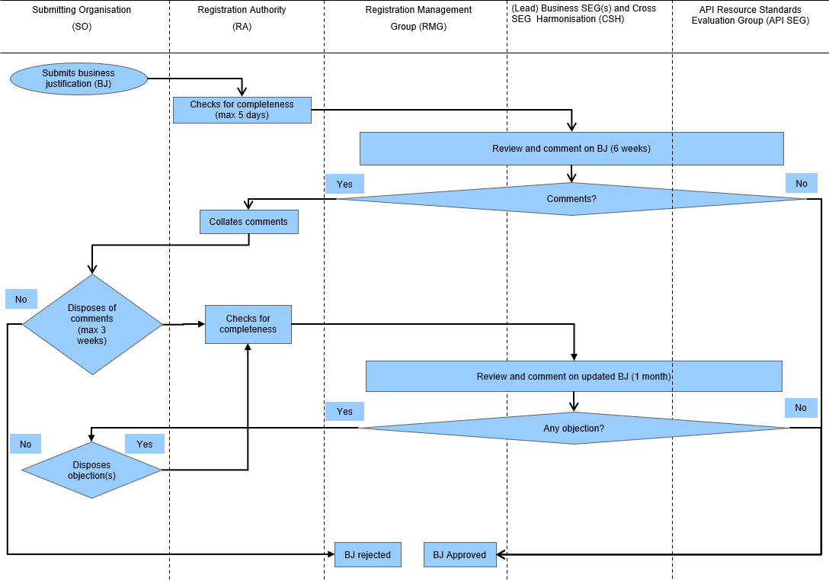
ISO 20022 API Resource Registration Process
New Business Justification approval sub-process

Slide 3
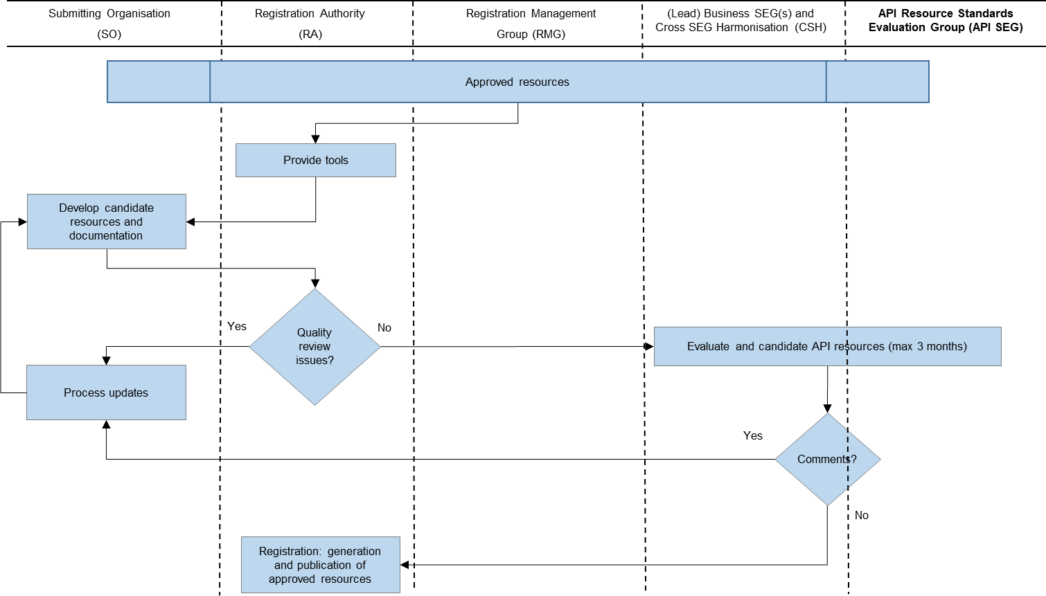
ISO 20022 API Resource Registration Process
API Resource development sub-process

Slide 4
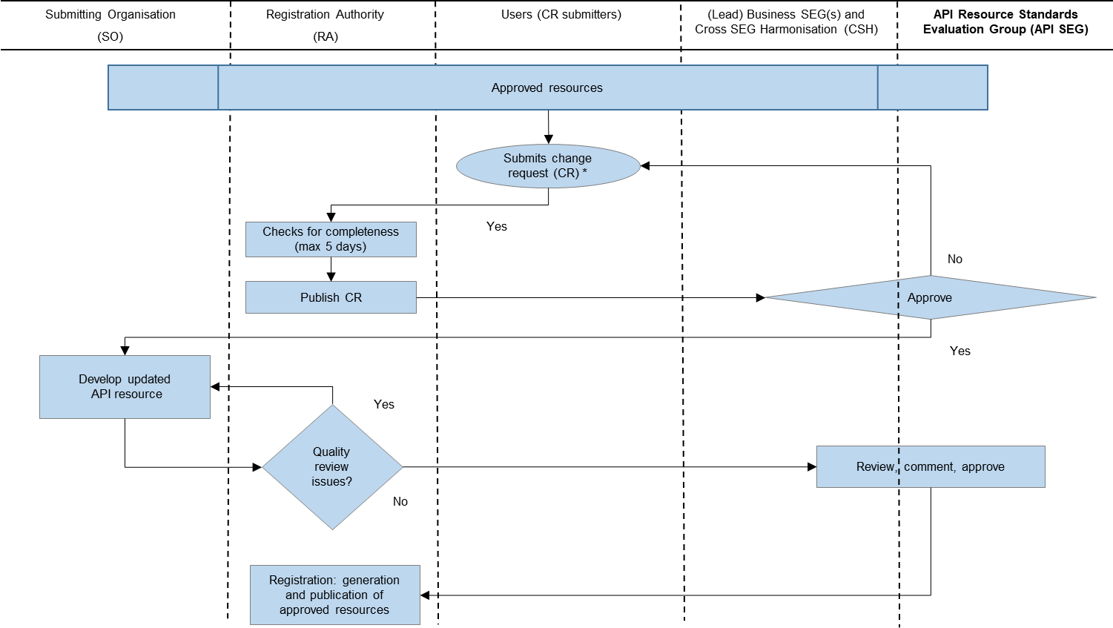
ISO 20022 API Resource Registration Process Resource maintenance sub-process

